Slide 1
Middle price range? But the highest life quality - Your exclusive Seattle Housing Insight
Ivy

Slide 2
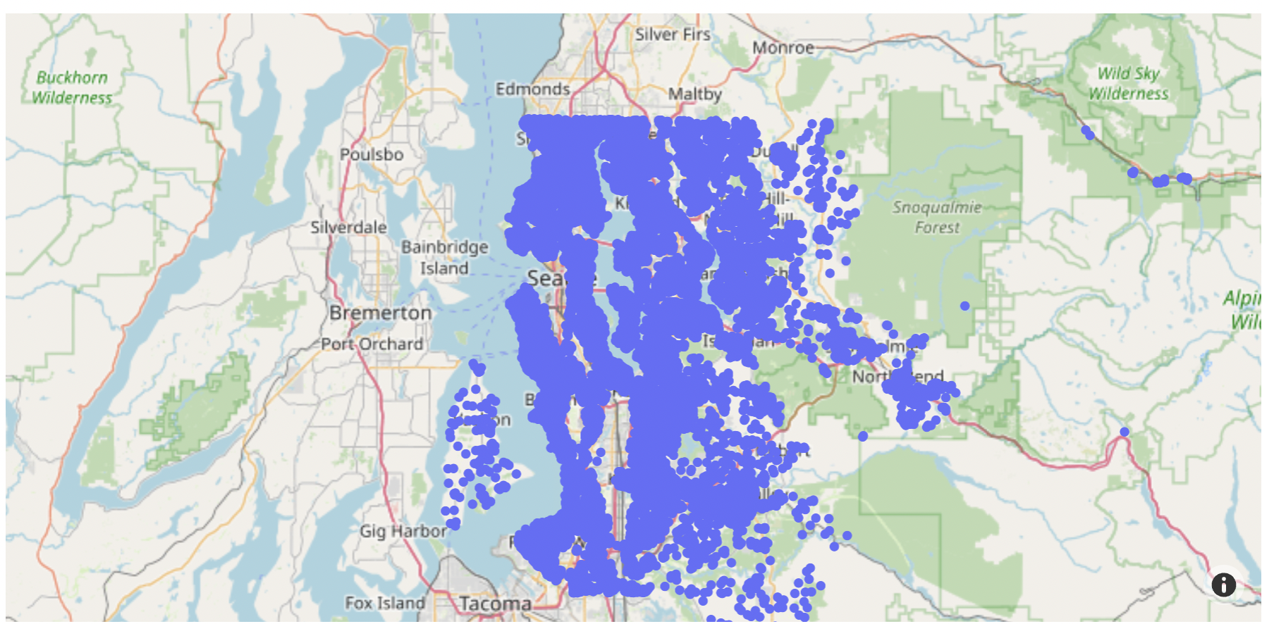
Overwhelmed? Not knowing what to choose?

Slide 3
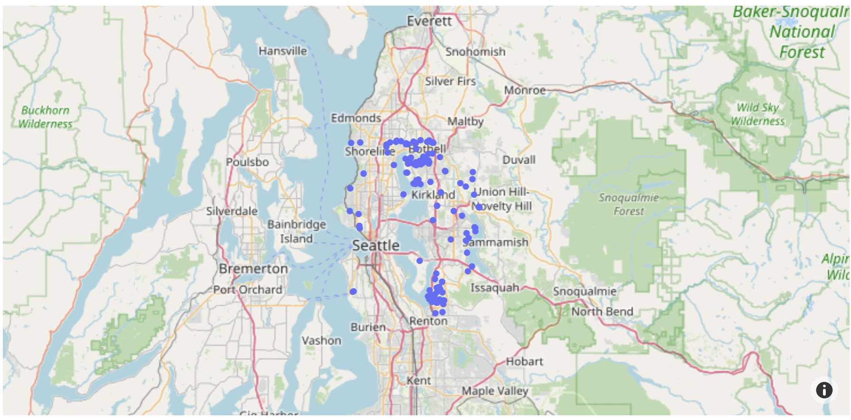
Locate your dream house: best area with best living quality

Slide 4
Housing
Segmentation
Breaking down 21597 housing data to 155 records that are tailored to your needs

Slide 5
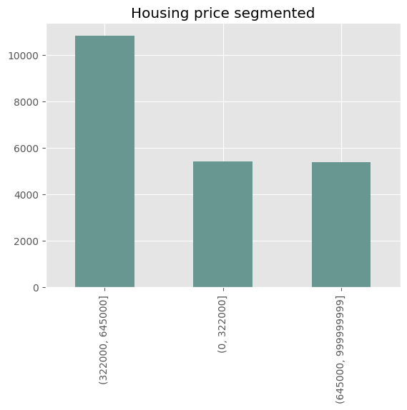
1. Middle price range
25% : $322000
50%: (median;) $450000
75%: $645000
From 21597 to 10832
Notes:
Comment: sort by price

Slide 6
2. Lively neighbourhood
Bigger living space in neighbours’ houses → More neighbours living around
Above median living space (1840 sqft) in neighbouring 15 houses
From 10832 to 5244

Slide 7
3. Central neighbourhood
Higher population density → More central location
Top 100 zip codes in Washington state (among 500+ zip codes)
From 5244 to 2574

Slide 8
4. Higher-income neighbourhood
Higher income level → Better living quality
Top 100 zip codes in Washington state (among 500+ zip codes)
From 2574 to 1644

Slide 9
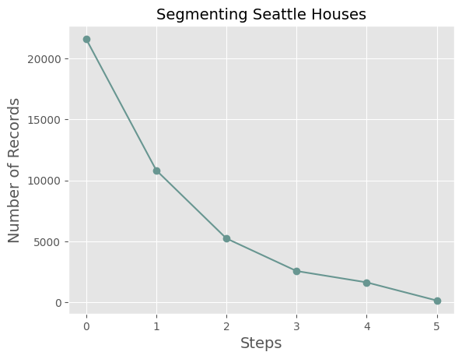
5. Quality of living
Condition of the house: at least 3
Grade of the house: at least 9
From 1644 to 155

Slide 10
Make your best decisions

Slide 11
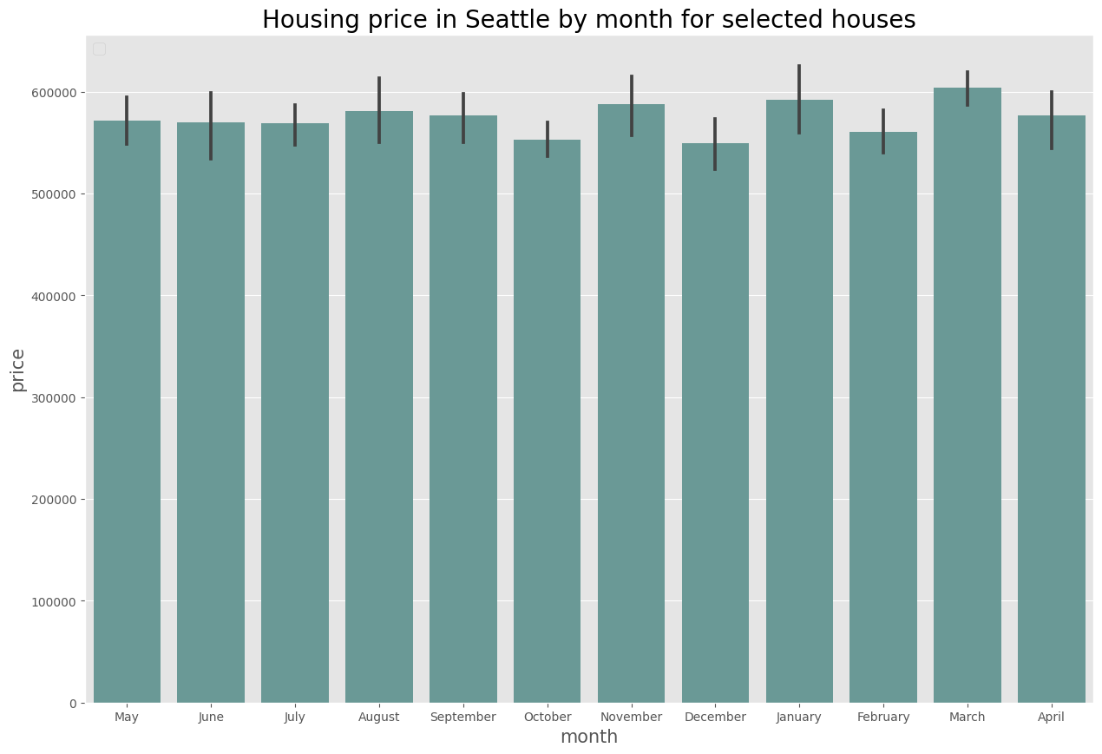
Best time of year to buy
December stands the best chance to buy an agreeable house at the lowest price, as it is the month with both the lowest mean price and the lowest minimum price.
Notes:
With large numbers pay attention to the formatting (500K or 500,000 is better than 500000)

Slide 12
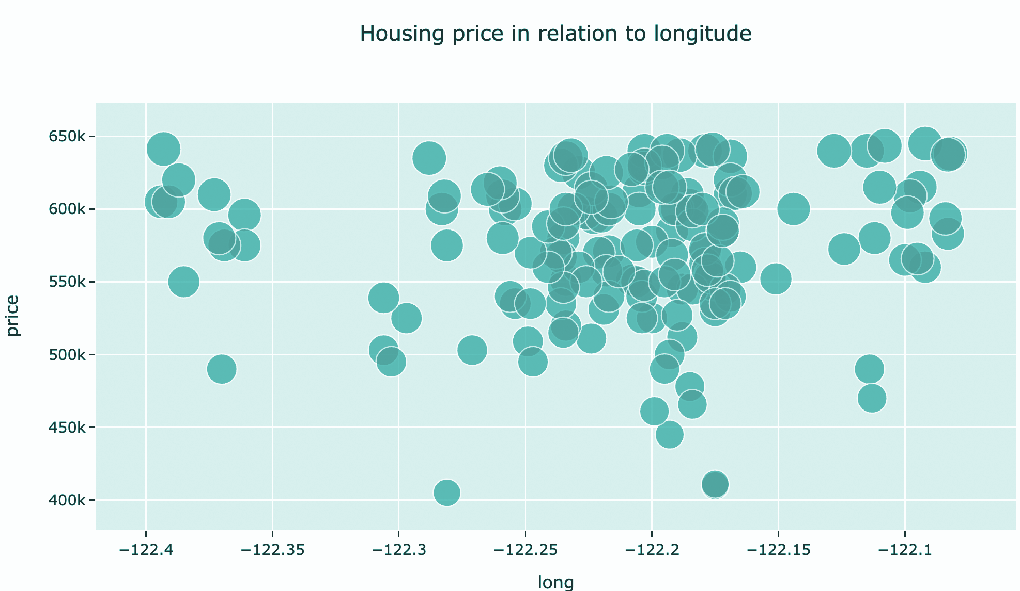
2. Best place to buy
Longitude: the more to the middle, the easier to find the cheaper price below 550K
Notes:
Comment: a map would be better to read and understand than this chart

Slide 13
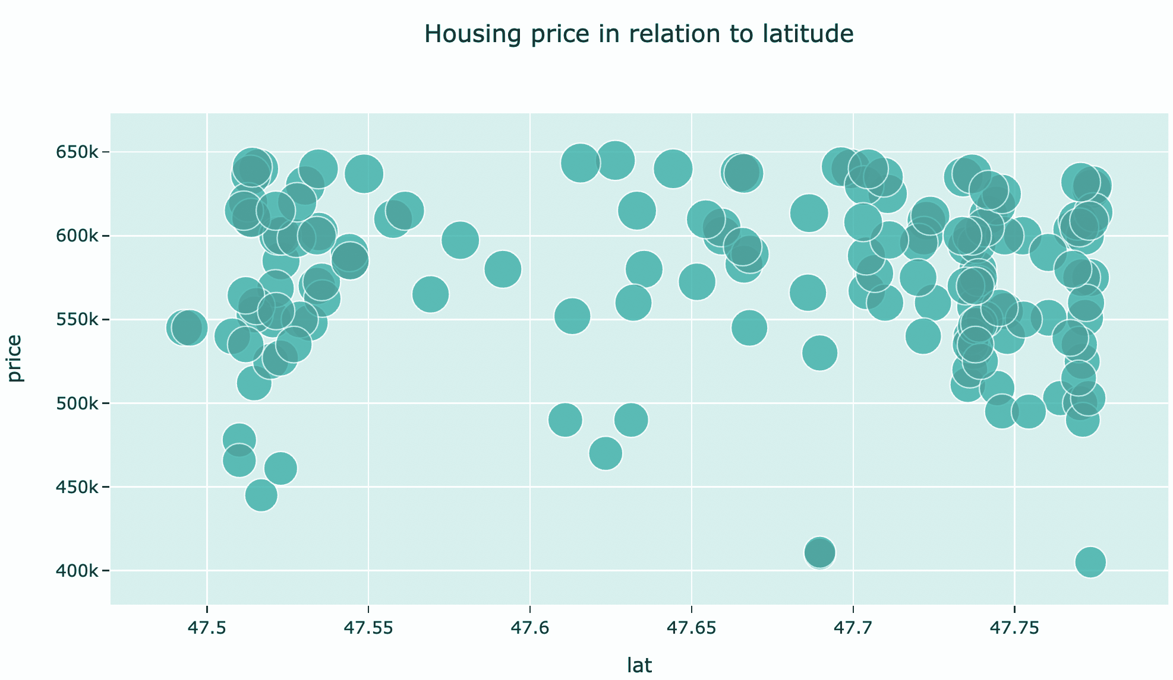
2. Best place to buy
Latitude: the more to either the south or the north, the easier to find the cheaper price below $550K
Notes:
Comment: a map would be better to read and understand than this chart

Slide 14
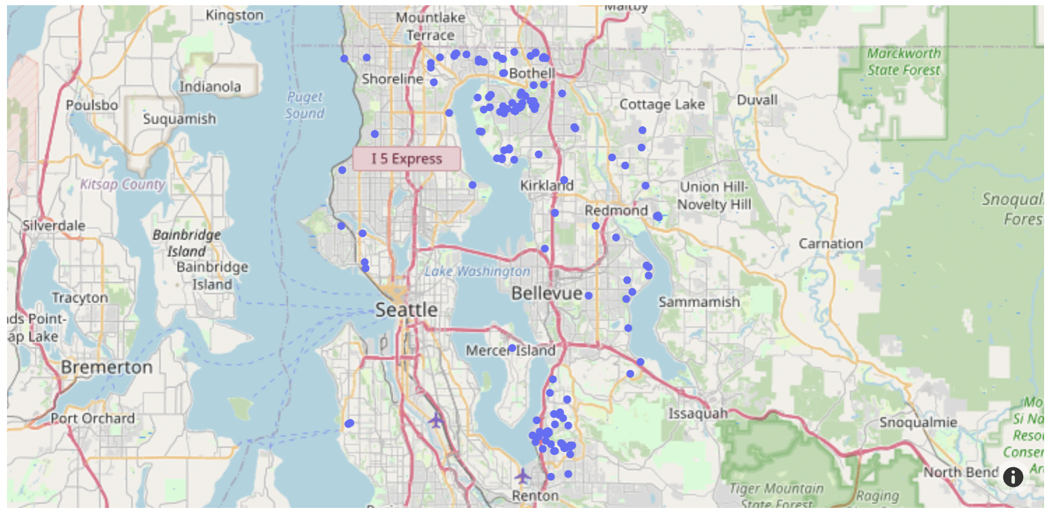
2. Best place to buy
Zip codes:
98011, 98056, 98052, 98028, 98008, 98155, 98033, 98119, 98034, 98007, 98199, 98177, 98040, 98006, 98004, 98117, 98136, 98115

Slide 15

3. Budget
Prepare $550K

Slide 16
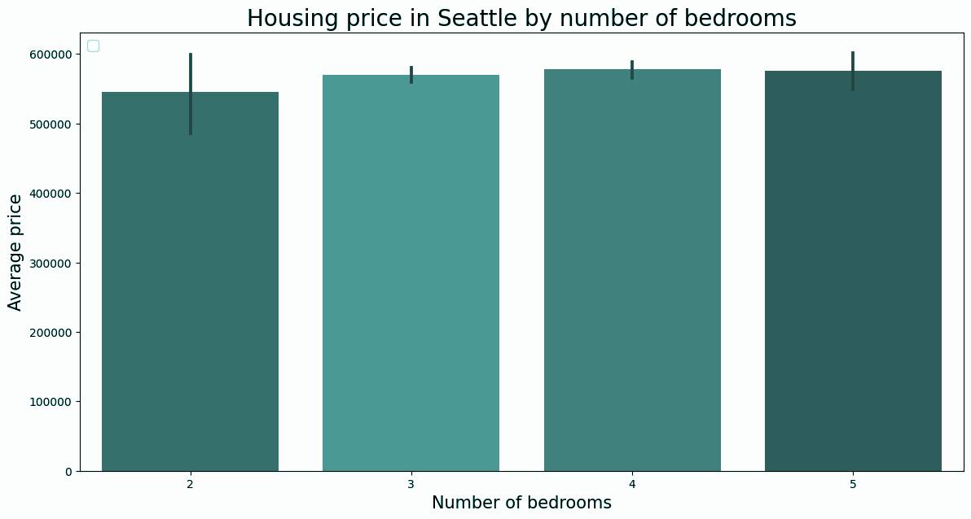
4. Living space
Number of bedrooms:
slightly positive correlation with the price.

Slide 17
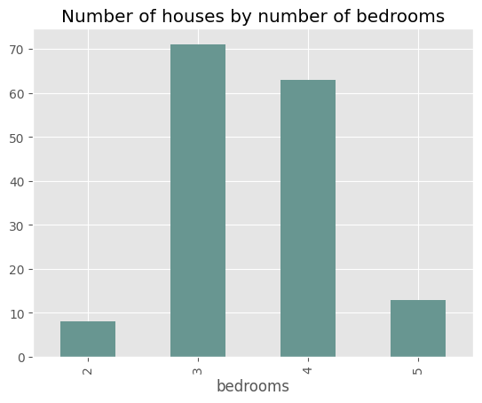
4. Living space
Number of bedrooms:
3 or 4 bedrooms are the most popular.

Slide 18
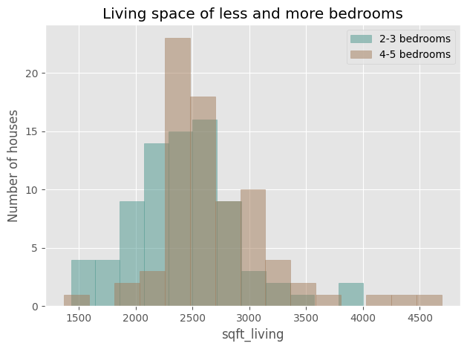
4. Living space
Number of bedrooms:
Overall, the more the bedrooms, the larger the living space are provided.
Notes:
Avoid using tech terms on the graph (sqft_living)

Slide 19
4. Living space
Living space:
Mode of 2-3 bedrooms are just above 2500 sqft, whereas mode of 4-5 bedrooms are just below 2500 sqft.

Slide 20

Summary
Best time to buy: December
Best place to buy: to the middle-north or middle-south of Seattle
Budget: $550K
The number of bedrooms: 3 or 4

Slide 21
Thank you

